Slide 1
Introduction to Modern NLP
with Hugging Face and CORD-19
Nick Acosta
Notes:
Deep Learning Frameworks allow for the easy construction of neural networks and have made Python the go-to language for Artificial Intelligence development. However, the most popular one, TensorFlow, only just had its 2nd major release, and many others are equally as new. The selection of which deep framework to learn can be a critical choice for beginning data scientists, and this meetup will introduce a method of selecting a deep learning framework by utilizing deep learning itself, and show how much new innovations such as transformers are changing both how to select a deep learning framework and the best models to build with them.
Python and experience with Jupyter Notebooks and NLP is recommended to attend/present this meetup

Slide 2
Before we start…
IBM Data & AI / May 12, 2020 / © 2020 IBM Corporation
2

Slide 3
Google Colab
ibm.biz/DSMeetup1

Slide 4
Agenda
Part One – Introduction 01
Setup 02
Agenda 04
Part Two - CORD-19 05
Producers and Kaggle competition 06
Example 07
Part Three - Hugging Face 08
NLP 09
Transformers the library 10
Transformers the models 11
Part Four – Lab 17
Part Five – Conclusion 20
Resources
Q&A
4

Slide 5
CORD-19

Slide 6
CORD-19

Slide 7
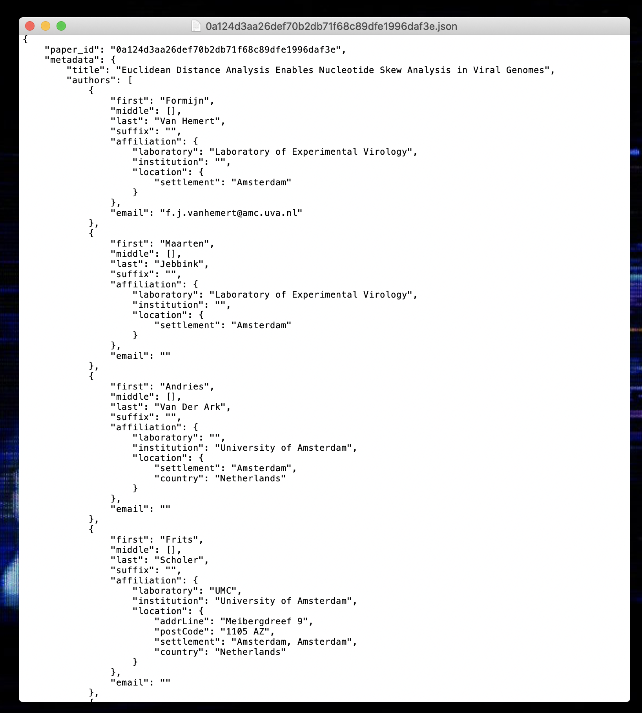
CORD-19

Slide 8
Hugging Face

Slide 9

NLP
Multiple Choice
Next Sentence Prediction
Sequence Classification
Token Classification
Question Answering
Text Generation
NLP
IBM Data & AI / May 12, 2020 / © 2020 IBM Corporation
9
Notes:
Natural Language Processing (NLP) is a branch of artificial intelligence concerned with understanding natural language
Technology can do this in a number of ways, just some on which are listed on the slide
Multiple Choice - The model correct selects an answer given multiple options. Guessing the next caption in a video.
Next Sentence Prediction - Given two sentences, a mode predicts whether the second came after the first “But the film is a saddening bore. Because I wrote it ten times or more” -> yes
Sequence Classification - The model assigns a sequence of text to a particular category. Sentiment analysis
Token Classification - Each word (token) is a sequence is classified against a list of options. Part-of-speech tagger
Question Answering - Given a paragraph of text, provide an answer to a question illustrating reading comprehension of the paragraph.
Text Generation - Given a sequence of text, a model prediction the next sequence(s) Google Search

Slide 10
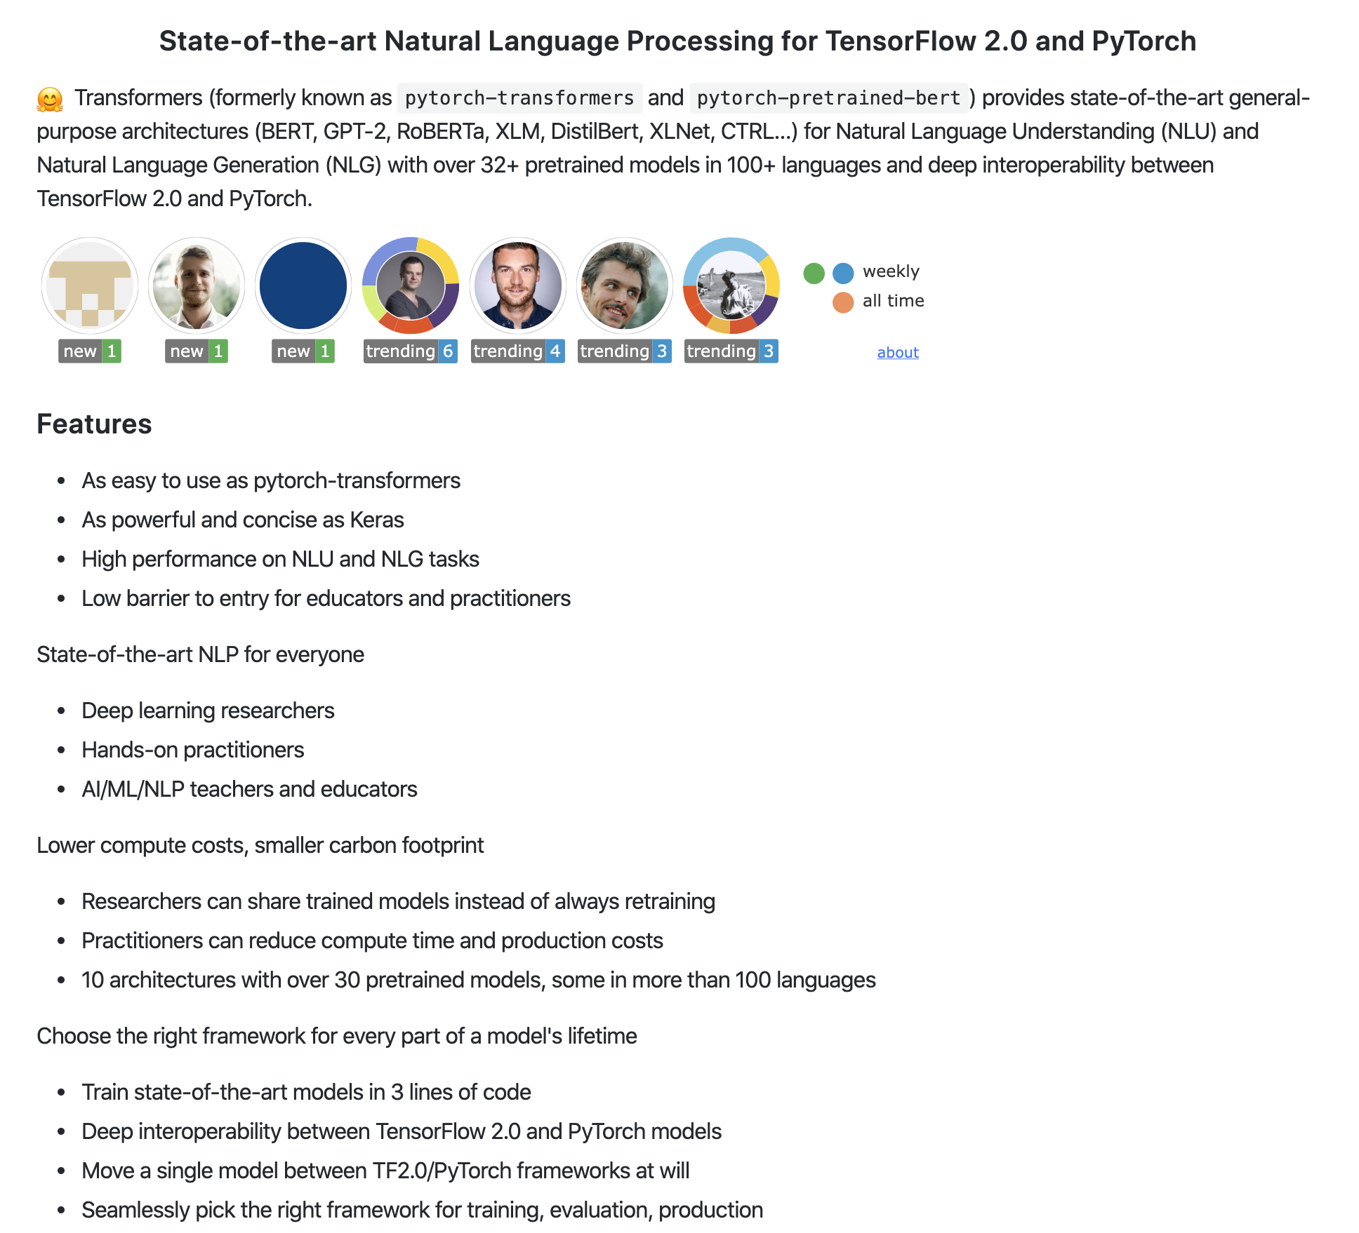
Transformers the library

Slide 11
Transformers the models
State of the art in multiple NLP tasks
Focus on self-attention and multi-headed attention
mixed frontend
M
11
Notes:
Transformers are gaining a lot of popularity recently for their state-of-the-art performance in a number of nlp tasks. More information on these breakthroughs are in coming slides

Slide 12
Transformers Resources
BERT Introduction
The Illustrated Transformer
The Illustrated GPT-2
12

Slide 13
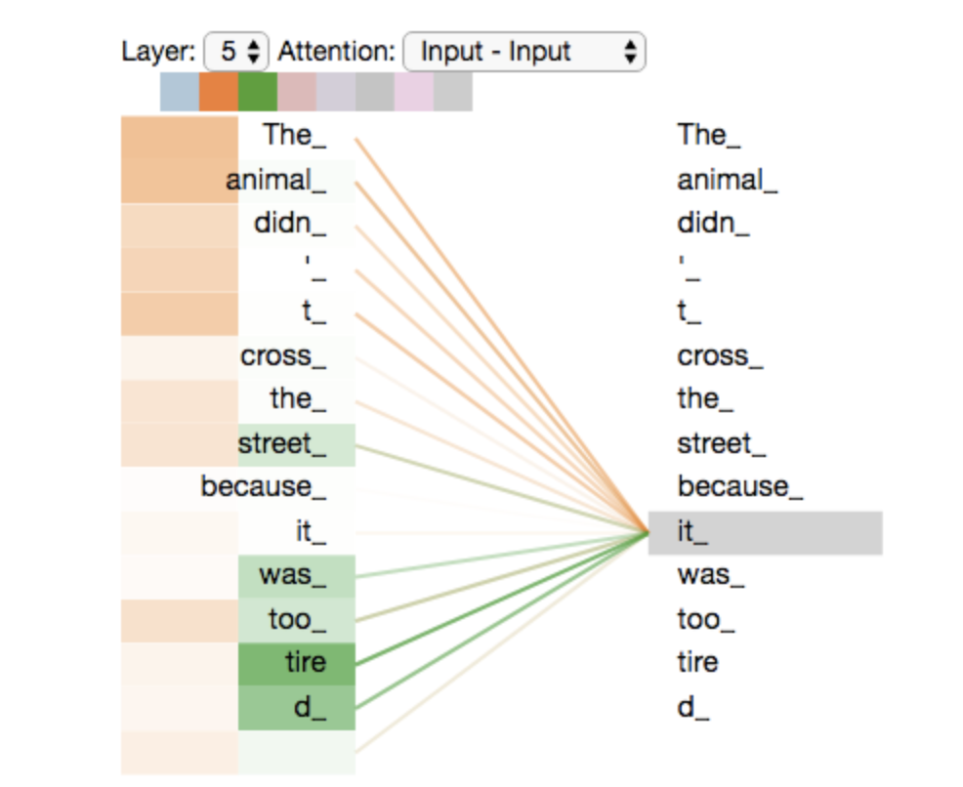
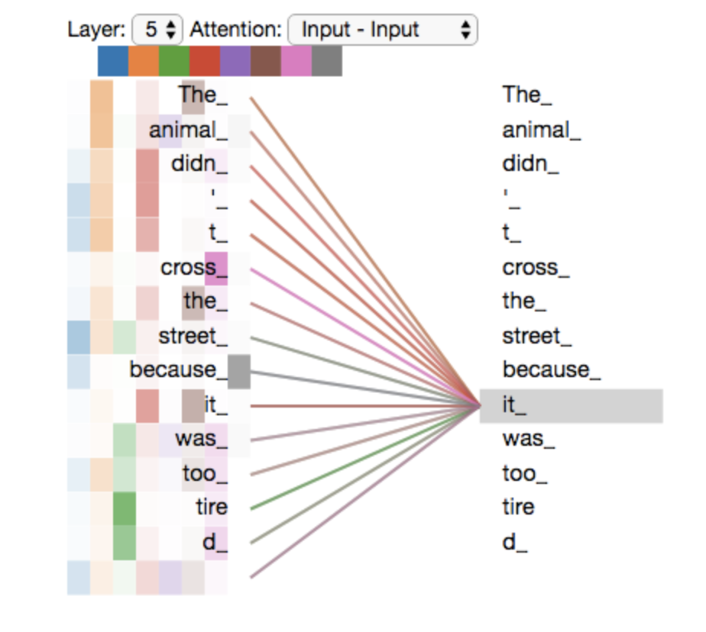
Self attention and multiheaded attention
13
Notes:
A key component of transformer models is attention. Transformers implement attention in a way that is parallelizable to speed training. Attention layers encode each input token by also examining all words surrounding the token in a sentence, and work particularly well on large sequences. These attention layers are also present in the decoding layers of a transformer model

Slide 14
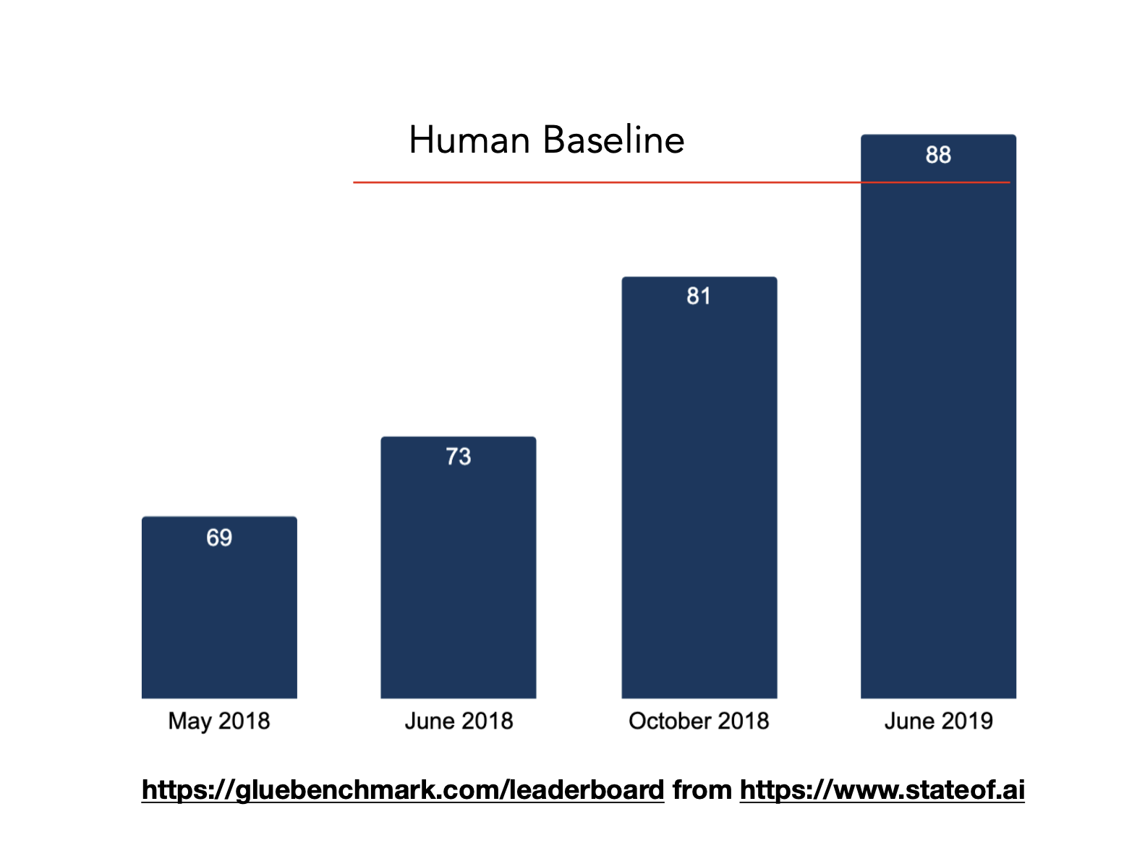
Transformers Results
14
Notes:
Transformers have led to a number of significant advancement in NLP.
Here you can see the accuracy for state-of-the-art models in performing text classification on the GLUE benchmark dataset, which passed even human performance just last summer.

Slide 15
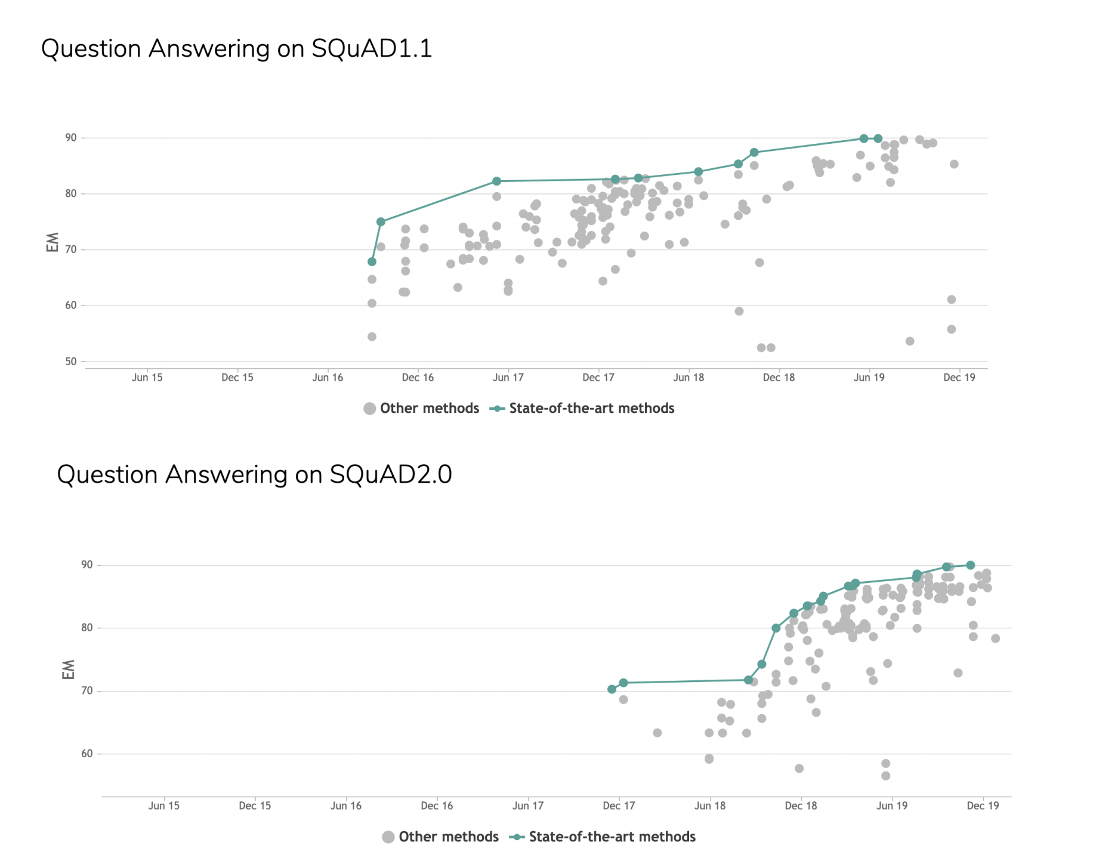
Transformers Results
15
Notes:
Every area of NLP is being affected. Here you can see how the state-of-the-art has rapidly progressed in the Question Answering domain on some SQuAD benchmarking datasets

Slide 16
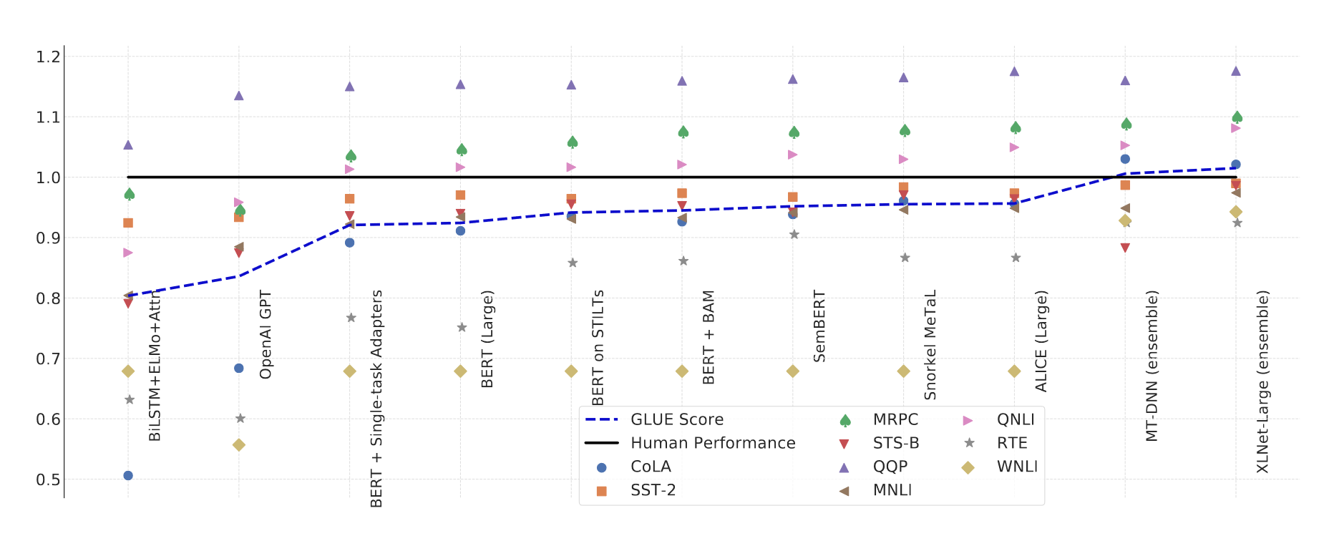
Transformers Results
16
Notes:
Further evidence that every area of NLP is being affected by transformers. Each dot on this graph represents a different NLP benchmarking task and dataset. The x-axis show various transformer model, and the y-axis show how many of the are outperforming, and sometimes significantly outperforming, humans in NLP tasks.

Slide 17
Lab
17
Notes:
This section will walk through examples of how the models on the previous slide can be used in a novel way, to classify and generate code of the deep learning frameworks mentioned earlier, TensorFlow and PyTorch

Slide 18
Acknowledgements
Daphne Ippolito
Denny Lee
Patrick von Platen
IBM Data & AI / May 12, 2020 / © 2020 IBM Corporation
18

Slide 19
Disclaimer
IBM Data & AI / May 12, 2020 / © 2020 IBM Corporation
19

